Slide 1
Testing and Debugging pt.2
Intro to Complexity
CS221 – 2/18/09

Slide 2
junit
Create a junit file for each class
Don’t share between classes – defeats the purposes
How to write a test:
  setup(): Any steps you need to take before testing starts
  Call each of the class methods you want to test
  Use junit assertions to pass/fail the test
  Any exception will cause the test to fail
  tearDown(): If you need to clean up after testing

Slide 3
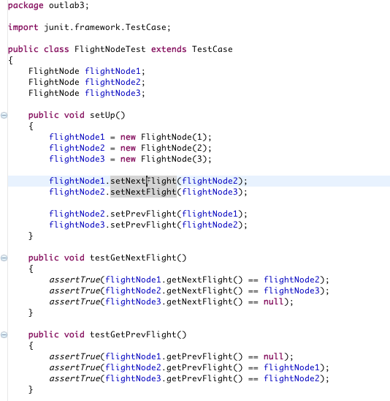
Example

Slide 4
Debugging
When to debug
  To track down a defect
  To understand an exception
  To trace the flow of execution, understand code
Key concepts
  Breakpoints: stop execution and give you control
  Single step: execute one line at a time
  Assertions: like a debug exception

Slide 5
Breakpoints
Line: Stops execution on the specified line
Method: Stops execution on the method
Watchpoint: Stops execution whenever the field is accessed or modified
Exception breakpoint: Stops execution when an exception is thrown
Class load breakpoint: Stops execution when a class is loaded

Slide 6
Breakpoint Example

Slide 7
Single Step
Step in: Steps into the method being called
Step over: Steps over the method being called
Step return: Steps out to the calling method
Run to line: Executes until the specified line of code

Slide 8
Single Step Example

Slide 9
Assertions
Usage:
  Assert something_true;
If the assertion fails you’ll get an exception
Requires –ea on the compiler command line
Assertions should be turned off when you are not testing or debugging
Where to use assertions
  Preconditions: Test parameter assumptions on a private method
  Test logical assumptions anywhere
  Postconditions: Test your return value assumptions

Slide 10
Assertion Example

Slide 11
Debugging Tips
Use inspect or variables window to see object values
Use breakpoints and step through code that is complex – make sure it works as you expect it
You can make changes to the code while debugging but it won’t affect execution till you restart
Breakpoints on each branch will quickly tell if you have good branch coverage
Use assertions to check logical conditions/assumptions in your code
  Assertions check logical assumptions
  Assertions only work if –ea is on compile command line

Slide 12
Testing and Debugging - Key Points
Purpose of testing is to understand and reduce risk
Unit/Integration/System/Acceptance
Use JUnit tests to automate granular testing on methods and classes
Black Box vs. White Box
Write code with testing cost in mind
Test Driven Development
  Build your tests first, then implement your solution
Use equivalency classes and boundary conditions to drive your testing
The debugger is your friend
  The more time you spend stepping through code, the better your understanding will be

Slide 13
Airline Program
Last class we covered:
  EmptyPassengerQueueException
  FlightNode
  FlightsList
Let’s quickly go over:
  Main
  PassengerNode
  PassengerQueue

Slide 14
Outlab
Modify FlightsList to use an Array
Add 2 methods that require search
Think about time complexity
Today and Friday should give you the tools to get this done

Slide 15
Complexity
Measures
  Implementation complexity (Cyclomatic)
  Time complexity (Big O)
  Space complexity (Also Big O)
Trade offs
  Simple to implement algorithm may have high time complexity
  Fast insertion may require additional space
  Reducing space may require additional time

Slide 16
Why is it Important?
Allows you to see when an algorithm is untenable
Allows you to compare competing algorithms and data structures
Saves you from hitting dead-ends
Allows you to estimate processor and storage load with increasing usage
Tells you where to look when making performance improvements
Allows you to make the right tradeoffs
  Implementation time
  Maintainability
  Time to execute/responsiveness
  Memory/Disk storage requirements

Slide 17
Time Complexity
Measures how many computational steps in relation to input
As the input set increases, how much impact on computation time?

Slide 18
Space Complexity
Measures how much storage in relation to input
As the input set increases, how much impact on storage requirements?

Slide 19
Big O Notation
O(1) – Linear. Very Nice!
O(log n) – Logarithmic. Nice!
O(n) – Linear. Good!
O(n log n) – Log-linear. Not Bad.
O(n^2) – Quadratic. Getting expensive.
O(n^3) – Cubic. Expensive.
O(2^n) – Exponential. Ouch!
O(n!) – Factorial. Holy Moly!!

